Slide 1
Instalog
Jacob Snyder jrs213@case.edu
Billy O’Neal bro4@case.edu http://code.instalog.org/
Notes:
Jacob

Slide 2
Outline
Background
Demo
Search Groups
ASEPs
Example Loading Points
Rootkits, SSDTs, and Limitations of User Mode
Further Work
Notes:
Jacob + Bill

Slide 3
Background
Diagnose and repair Windows installations
Log everything on a Windows machine
Registry
Files
Processes
Etc.
Generate and run fix scripts (Eventually)
Three user classes:
Home users
Administrators
Forum Experts
Scope limit for this semester -> scanning features
Notes:
Jacob
Mention HJT and other tools

Slide 4
Demo!
(You can pay attention now)
Notes:
Bill/Jacob

Slide 5
Search Groups
Running Processes
Services / Drivers
Installed Programs (HKLM\..\Uninstall)
Internet Explorer / Firefox / Chrome Settings
Miscellaneous ASEPs
“Interesting” Files
Hardware Diagnostics
Notes:
Jacob
Home pages / Search providers
Autostart Extensibility Points
Interesting == Executable in the root of %PROGRAMFILES%

Slide 6
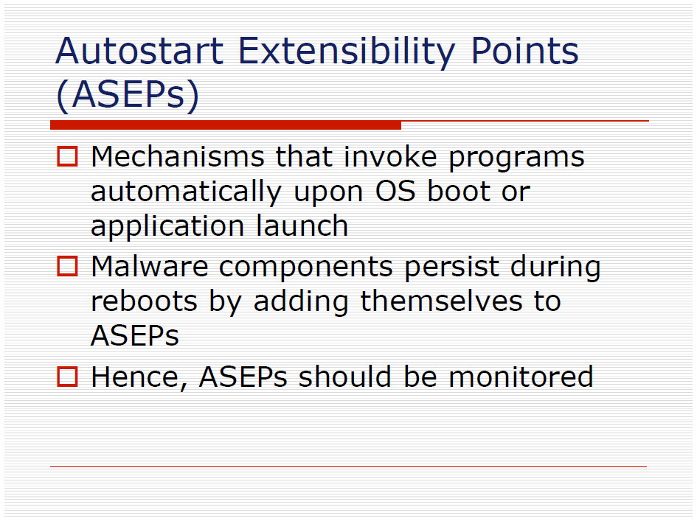
Notes:
Jacob

Slide 7
Example Loading Points
Task Manager
Browser Helper Objects (BHOs)
Registry Autostarts
Winsock Layered Service Providers (LSPs)
Notes:
Jacob

Slide 8
Task Manager
[HKLM\Software\Microsoft\Windows NT\CurrentVersion\Winlogon]
“TaskMan”=“${Task Manager Binary}”
This binary is launched when the user selects “Task Manager” from the Ctrl+Alt+Delete menu (on older versions of Windows)
This value is used to launch alternate task managers, such as Process Explorer
Malware sometimes hijacks this to prevent users from terminating it
Notes:
Jacob

Slide 9
Browser Helper Objects
[HKLM\Software\Microsoft\Windows\CurrentVersion\Explorer\
Browser Helper Objects\${CLSID}]
@="${AlternateName}"
[HKEY_CLASSES_ROOT\CLSID\${CLSID}]
@="${Name}"
[HKEY_CLASSES_ROOT\CLSID\${CLSID}\InProcServer32]
@="${File}"
These are Internet Explorer plugins (Flash, PDF readers, Silverlight, Java Browser Plugin, etc.)
Of course, not all plugins have the user’s best interest in mind (Flash?)
Notes:
Bill

Slide 10
Registry Autostarts
[HKLM\Software\Microsoft\Windows\CurrentVersion\Run]
"${Name}"="${File}"
[HKLM\Software\Microsoft\Windows\CurrentVersion\RunOnce]
"${Name}"="${File}"
[HKLM\Software\Microsoft\Windows\CurrentVersion\RunServices]
"${Name}"="${File}"
[HKLM\Software\Microsoft\Windows\CurrentVersion\RunServicesOnce]
"${Name}"="${File}"
[HKLM\Software\Microsoft\Windows\CurrentVersion\
Policies\Explorer\Run]
"${Name}"="${File}"
These are “standard” autostart locations
We check these just for sanity’s sake – most malware doesn’t use these anymore
Notes:
Jacob

Slide 11
Layered Service Providers
[HKLM\SYSTEM\CurrentControlSet\Services\Winsock2\Parameters]
Actually looks at several slides’ worth of registry information –not worth including here (see specification)
LSP components can inspect/modify all user-mode network traffic
Used to implement older firewalls
Can be used to forward legitimate web requests to malicious sites
Breaking the LSP chain prevents network access
Notes:
Bill
(Remember, Ukraine)

Slide 12
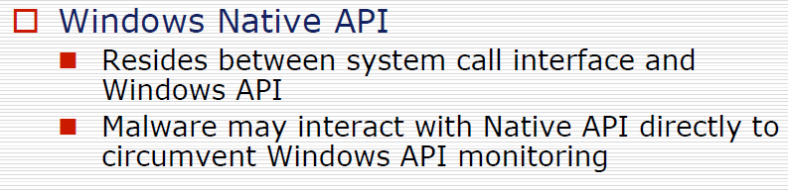

Slide 13
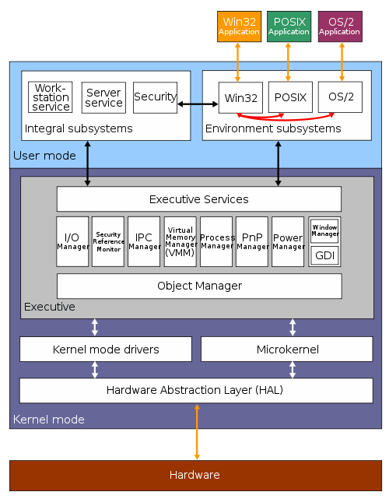
Native API
Source: Wikipedia
Notes:
Bill

Slide 14
Native API
Windows API: FindFirstFile/FindNextFile
Native API: NtQueryDirectoryFile
Instalog.exe
Kernel32.dll
Ntdll.dll / NTOSKRNL.EXE
(Instalog cheats a bit and calls the Native API directly)
Notes:
Bill

Slide 15
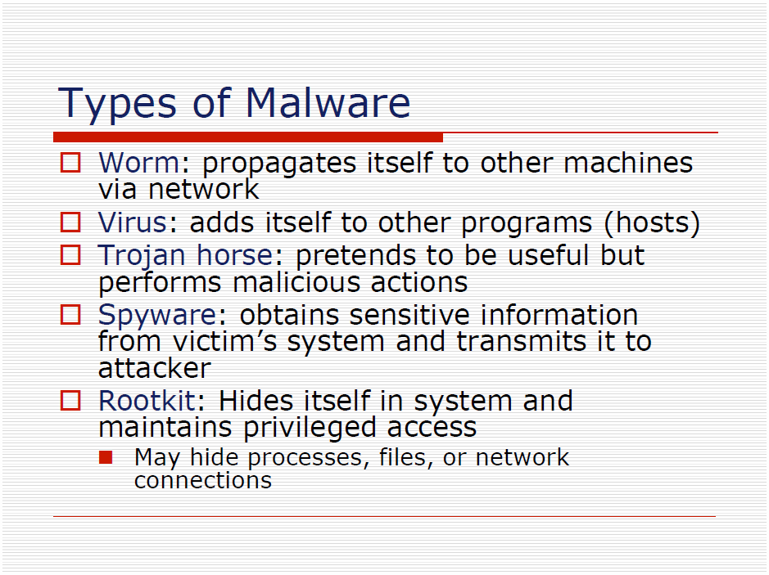
Notes:
Bill

Slide 16

Limitations: Rootkits and SSDT
Most of this content is from the Rootkits: Subverting the Windows Kernel book:
Notes:
Bill

Slide 17
X86 Privilege Levels
Kernel mode code
Has access to all memory
Responsible for enforcing memory access control policy (
User mode code
Prevented from tearing down the system by kernel policy
User mode needs to call the kernel for operating system services (such as enumerating a directory)
Notes:
Bill

Slide 18
System Service Dispatch Table
Allows user mode code to make a system call into kernel mode
Basically a large table of function pointers to kernel services
User mode code requests any kernel mode service through a single processor instruction. (Currently SYSENTER on modern versions of Windows)
This is an example of how rootkits might hijack Instalog (or any other User Mode tool) -- modifying entries in the SSDT
Anti Rootkit (ARK) tools check for these sorts of things, but they require drivers to do this
Notes:
Bill

Slide 19
Future Work
Graphical User Interface
Scriptability
Improved Whitelisting
Forked by commercial entity (e.g. Malwarebytes)
Notes:
Jacob (And Bill for the last point)

Slide 20
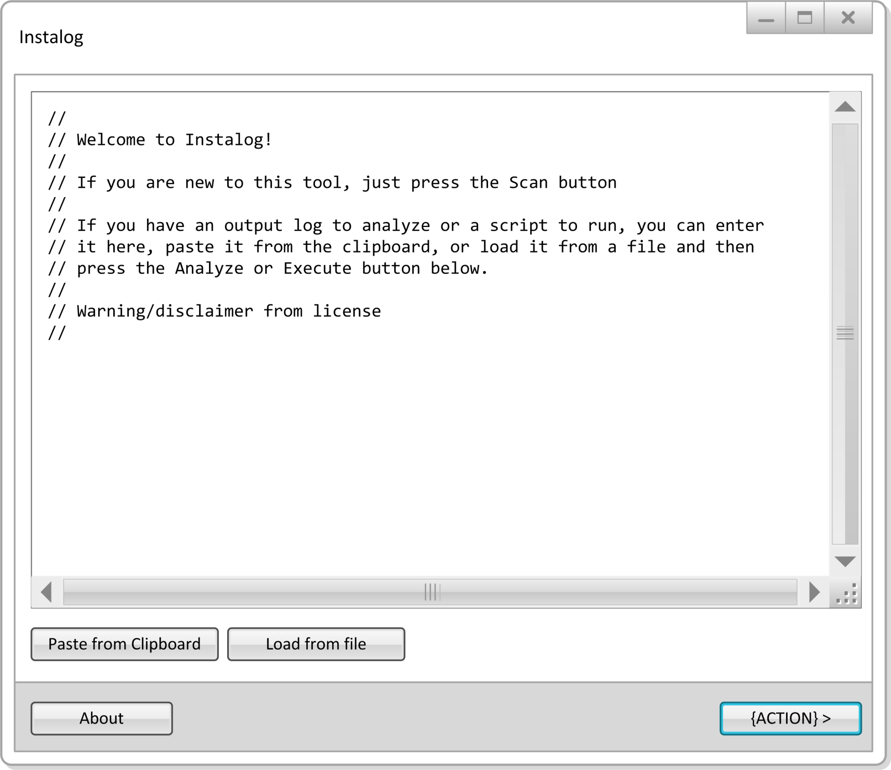
Notes:
Jacob

Slide 21
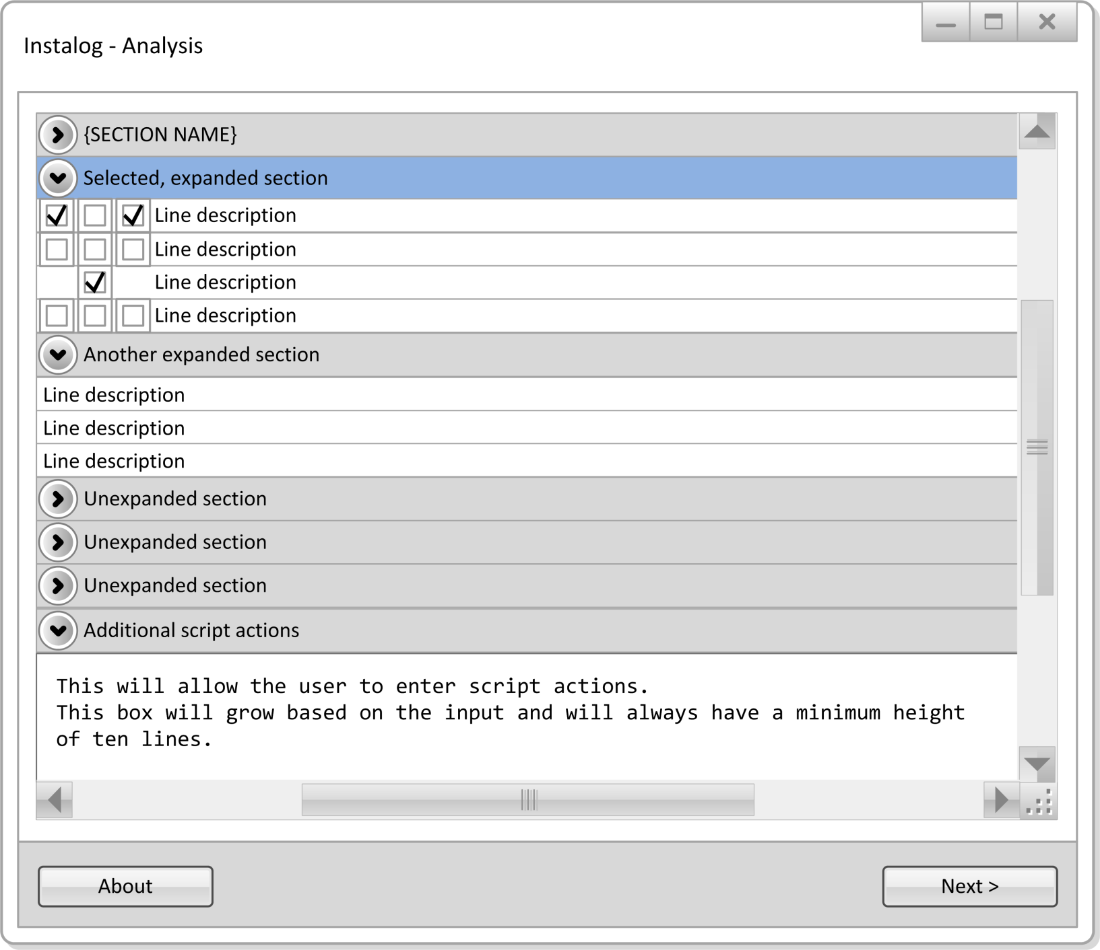
Notes:
Jacob

Slide 22
Questions?
More information available online:
http://code.instalog.org/ (forwards to bitbucket)
Updated documentation
Source Code
Issue Tracking
Wiki
BSD Two-Clause License
Notes:
??????

